Slide 1

tliq Business Insights 360
transformative journey leveraging Power BI for data analytics.

Slide 2

Business Insights 360
A transformative journey leveraging Power BI for data analytics.
In this initiative, we explore AtliQ Hardware's global operations, aiming to extract meaningful insights that will drive informed decision-making.
01
INTRODUCTION
Learning Journey
Guided by “codebasics” mentors Dhaval Patel and Hemanand Vadival.
Specific skills gained during this project –
Power Query, ETL methodology, DAX, measures.
Creative use of Buttons, Parameters, Bookmarks.
Page navigation with hovering effect
Dynamic titles based on applied filters.
Distinct KPI indicators.
Creative conditional formatting using icons or background colours.
Data validation strategies that align with our unique business needs.
Comprehensive Power Bi services integration And much more..

Slide 3
Introducing AtliQ Hardware
A significant player in the electronics market, operates globally, catering to retailers, distributors, and internal channels.
Aims to enhance decision-making processes, ensuring a more resilient and competitive position in the industry.
Data Sets Details
Foundation: Dimension and Fact Tables
Dimension tables house static data and provide context and descriptive information - (dim customer, market, product, date)
Fact tables contain transactional data, capturing the details of various business transactions - (sales monthly, forecast monthly, operation expenses).
02
PROJECT OVERVIEW
ETL Process
Extract, Transform, Load (ETL) process was paramount wiith meticulous extraction and transformation using Power Query in Power BI from SQL server.
We crafted a robust data model with multiple fact and dimension tables.

Slide 4
Snowflake schema
A structured data modeling method with a hierarchical tree-like structure, with fact tables at the centre of numerical data and dimension tables branching out to provide contextual details.
Emphasizes data normalization by breaking down tables into smaller, related tables.
This method enhances data integrity, ensuring our information is accurate and reliable.
03
DATA MODEL
Unveiling Key Measures
Over 60 key measures have been crafted to provide a nuanced understanding of the data.
These measures serve as crucial metrics for insightful analysis, effective reporting.

Slide 5
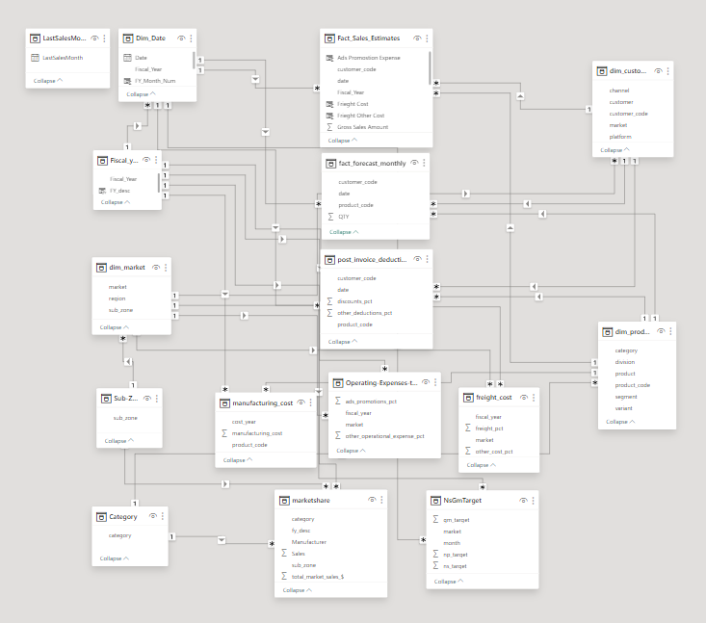
DATA MODEL DIAGRAM

Slide 6
Crafting Interactive Reports
Live dashboard features a user-friendly home page and dedicated sections for Finance, Sales, Marketing, Supply Chain, and Executive View.
Comprehensive reporting structure ensures a holistic view of AtliQ Hardware's performance.
The sales data is up-to-date as of December 21st.
The Report was last Refreshed with new data on Date: 05 November 2023"
Currency is in INR.
04
REPORTING OVERVIEW
Interactive Features
Experience seamless navigation with interactive features and filters that enhance user engagement
Providing a dynamic and personalized analysis experience.
Explore in Real-Time experience for comprehensive view of the analytical journey.

Slide 7
Financial Insights
The dashboard offers a detailed overview of AtliQ Hardware's financial performance with -
Profit and loss statements, key metrics (Net sales, gross margin, net profit), performance trend and benchmarks
These visuals assist the finance team with -
A clear and actionable snapshot of the company's financial health,
Empowering them to make data-driven decisions, optimize resources, and collaborate effectively.
Revealing profitability, cost drivers, sales trends, and historical data,
Enable them to understand the present, forecast the future, and make strategic decisions for sustainable growth.
05
FINANCE VIEW

Slide 8
Sales Performance Unleashed
Provides a granular understanding of AtliQ Hardware's sales dynamics like -
Comprehensive report on net sales, gross margin of top-performing products, customer net sales performance
The dashboard can assist the sales team by -
Tracking their sales against their targets and identify areas where they need to improve,
Develop new sales strategies such as offering discounts or promotions to certain customer segments.
Identifying products and customers have the highest margins and net profits.
Focus efforts on acquiring and retaining customers in these areas.
06
SALES VIEW

Slide 9
Marketing Unveiled
Providing insights into AtliQ Hardware's marketing strategies and performance metrics.
The marketing team can use these visuals -
For information to identify areas where the segment is underperforming.
For example, they may want to focus on improving the performance of the Networking product or the Notebook channel.
To allocate resources to the most profitable products and channels.
For example, spend more marketing by promoting the Notebook product or the Desktop channel.
To develop targeted marketing campaigns for different products and channels.
For example, develop a campaign to promote the Notebook product to students or a campaign to promote the Desktop channel to businesses.
07
MARKETING VIEW

Slide 10
Navigating the Supply Chain
Offering a closer look at the intricate processes that drive the business.
Forecast accuracy for customers is 81.17%, from 80.21% from previous year. A positive trend, in predicting customer demand.
The net error is -$3.47 million, which means that the team is under-forecasting by this amount.
The supply chain team can use this dashboard:
For the information to identify areas where they can improve their forecasting accuracy.
For example, focus on improving their forecasting accuracy for Acclaimed Stores or the Storage segment.
They can also use this information to develop targeted inventory management strategies for different customers and products.
For example, hold more inventory for Amazon or Networking products, and less inventory for Acclaimed Stores or Storage products.
08
SUPPLY CHAIN VIEW

Slide 11
Insights for Leadership
A dashboard offering insights into revenue by division, channel, annual trends, market shares, top customers, and top products.
Provides insights of major KPIs –
Revenue, Gross margin, Net profit margin are slightly below target.
Forecast accuracy: 81.17%, which is good but there is still room for improvement.
Net profit margin has been declining year-over-year.
Retailer channel is performing well.
The executive team can use this dashboard -
To identify areas where they can improve and they may want to ask
What are the reasons for the low net profit margin?
What is being done to improve forecast accuracy?
To track progress over time and measure the effectiveness of the actions taken by the executive team.
To communicate the plan to all employees and stakeholders.
Ensuring that everyone is on the same page and working towards the same goals.
09
EXECUTIVE VIEW

Slide 12
THANK YOU

